Slide 1
Simulation & Physics
2016-2017

Slide 2
geometry
Distance, Angle, Normal vector

Slide 3
length of a vector 2D
A
3
2
a
1
−1
0
1
2

Slide 4
length of a vector 3D

Slide 5
normalized vector
Normalized vector is a vector scaled to length 1
are normalized
vectors

Slide 6
distance between two points 2D
Given two points A(a₁,a₂) and B(b₁,b₂):
Distance between the points equals the length of the connection vector
d(A,B) =
A
B
d(A,B) =

Slide 7
Squared length of a vector

Slide 8
distance between two points 3D
Given two points A(a₁,a₂,a₃) and B(b₁,b₂,b₃):
Distance between the points equals the length of the connection vector
d(A,B) =
A
B

Slide 9
exercise
Sowiso question 2.1.1, 2.1.2, 2.2.1
When finished:
Make the exercise again with pen and paper and check the results of your neighbor.
(not with the same values as in the first question)

Slide 10
Simulation: bouncing
We have seen how to bounce against horizontal or vertical lines (e.g. screen bounds)

Slide 11
Simulation: bouncing
But what to do when an object bounces against a line with a different rotation?

Slide 12
Simulation: bouncing
But what to do when an object bounces against a line with a different rotation?
?

Slide 13
Simulation: bouncing
But what to do when an object bounces against a line with a different rotation?

Slide 14
Simulation: bouncing
But what to do when an object bounces against a line with a different rotation?

Slide 15
Simulation: bouncing
But what to do when an object bounces against a line with a different rotation?
Math

Slide 16
angle between vectors
Use the cosine rule
b
φ
a
O
|b - a|² = |a|² + |b|² - 2|a||b|cos ϕ
This works in 2D and in 3D ☺

Slide 17
angle formula 2D
|b - a|² = |a|² + |b|² - 2|a||b|cos ϕ
Notes:
Schrijf eventueel de afleiding op het bord.

Slide 18
dot product 2D
Definition: The number a₁b₁ + a₂b₂ is called the dot product (inproduct)
Notation: a · b is the dot product of two vectors
a · b = a₁b₁ + a₂b₂

Slide 19
angle formula

Slide 20
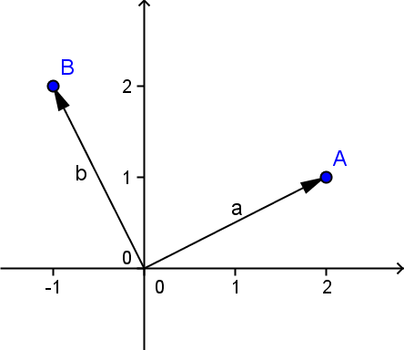
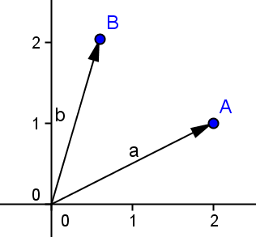
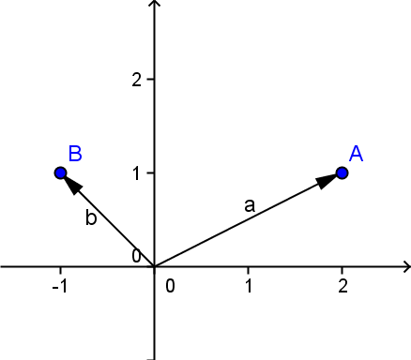
right, acute, obtuse
right angle
obtuse angle
acute angle

Slide 21
dot product 3D
Definition: Number a₁b₁ + a₂b₂ + a₃b₃ is the dot product (inproduct)
Notation: a · b is the dot product of two vectors
a · b = a₁b₁ + a₂b₂ + a₃b₃

Slide 22
angle formula 3D

Slide 23
exercise
Sowiso question 2.4.2
When finished:
Make the exercise again with pen and paper and check the results of your neighbor.
(not with the same values as in the first question)

Slide 24
perpendicular vector 2D
Notes:
Minnetje kan zowel boven als onder.

Slide 25
example perpendicular vector 2D

Slide 26
example perpendicular vector 2D

Slide 27
vector geometry
Dot product and equations

Slide 28
equation as dotproduct
Line l with equation: 2x + 5y = 0
Read as dotproduct:
Vectors are perpendicular:

Slide 29
line through origin
5
l: 2x + 5y = 0
4
3
vector n is perpendicular to line l
n
2
l
1
vector n is called a normal vector of line l
−1
0
1
2
3
4
5
−1
−2

Slide 30
parallel line
5
m: 2x + 5y = 8
line m is parallel to line l: 2x + 5y = 0
4
3
n
vector n is perpendicular to line m
m
2
1
vector n is also normal vector of line m
−1
0
1
2
3
4
5
−1
−2

Slide 31
normalvector of a line
l: ax + by = c
Vector:
is a normal vector of line l
Normal vector of a line is perpendicular to the line

Slide 32
direction and normalvector
l: ax + by = c
l
3
r
2
n
perpendicular to vector:
1
s
−1
0
1
2
3
−1
is direction vector of the line

Slide 33
equation to vectors
equation:

Slide 34
equation to vectors
equation:
normalvector:

Slide 35
equation to vectors
equation:
normalvector:
direction vector:

Slide 36
equation to vectors
equation:
direction vector:
point of l: (0, –2)

Slide 37
equation to vectors
equation:
direction vector:
point of l: (0, –2)
vector equation:

Slide 38
vectors to equation
vector equation:

Slide 39
vectors to equation
vector equation:
direction vector:

Slide 40
vectors to equation
vector equation:
direction vector:
normalvector:

Slide 41
vectors to equation
vector equation:
direction vector:
normalvector:

Slide 42
vectors to equation
vector equation:
normalvector:
point of l: (–1, 3)

Slide 43
vectors to equation
vector equation:
normalvector:
point of l: (–1, 3)
normal equation:

Slide 44
exercise
Sowiso question 2.7.3 en 2.7.4
When finished:
Make the exercise again with pen and paper and check the results of your neighbor.
(not with the same values as in the first question)

Slide 45
length and dotproduct

